Slide 1
Optimal Mix of Renewable Power Generation in the MENA Region as Basis for an Efficient Electricity Supply to Europe
Alaa Alhamwi, David Kleinhans, Stefan Weitemeyer, Thomas Vogt
3rd European Energy Conference - E2C 2013
October 29th, 2013

Slide 2
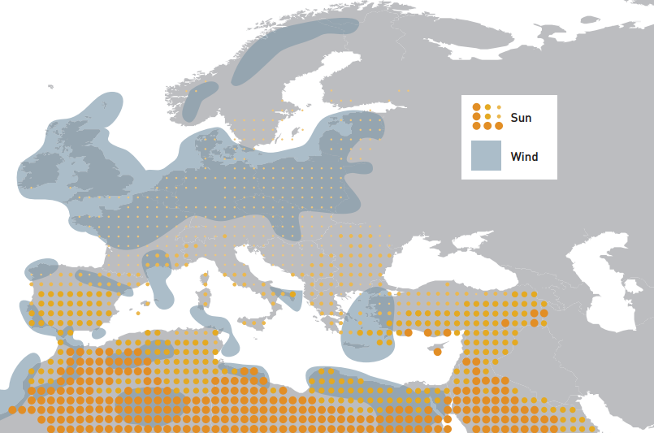
Background
15% of the European electricity needs can be provided by solar electricity imports from MENA (DLR, 2009)
“A well balanced mix of renewable energies can replace electricity from fossil fuels” (MED-CSP, 2005)
Source: (Fraunhofer and Dii, 2012)

Slide 3
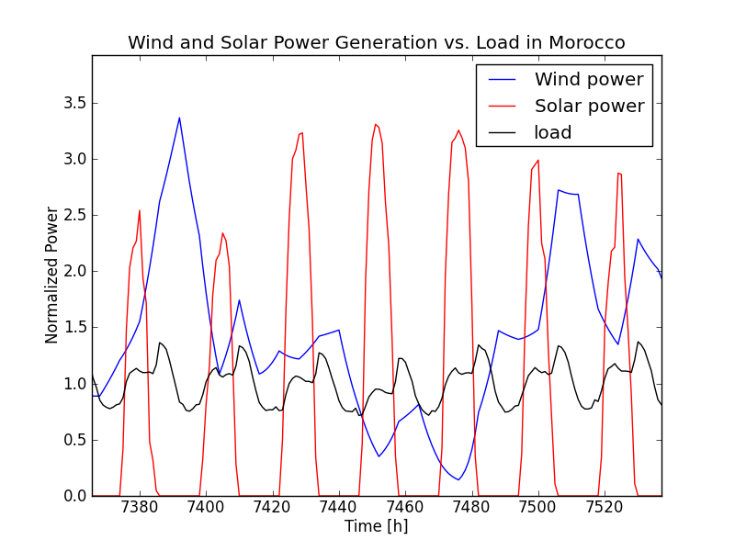
Background
Motivation
Renewables have fluctuating and dynamic behaviour → storage needs →
What is the optimal mix of renewables in Morocco?
@ the minimum required storage

Slide 4
Outline
Background
Country Profile
Methodology
Scenarios definition
Optimal mix analysis
Storage model
Optimal mix results
Discussion
Conclusion

Slide 5
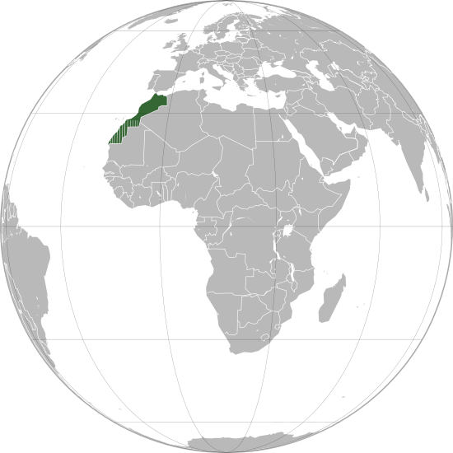
Country Profile
Morocco as a case study
Electricity demand growth rate 7-8 % per year
Technical supply potentials of renewables
Grid interconnection with Spain and Algeria
Data availability and accessibility
National Energy Strategy
 | CSP (TWh/year) | Wind (TWh/year)
Morocco | 20.151 | 1.188
Spain | 1.646 | 226
33 millions inhabitants (2012)
25 TWh electricity consumption (2010)
Source: DLR, 2005

Slide 6
Country Profile
Electricity mix in Morocco
2012 | Wind | Solar | Hydro | Total RE | Total
Installed capacity MW | 340 | 35 | 1745 | 2120 | 6723
2020 | Wind | Solar | Hydro | Total RE | Total
Installed capacity MW | 2000 | 2000 | 2000 | 6000 | 14500
Source: RCREEE Renewable Energy Country Profile - Morocco, 2013

Slide 7
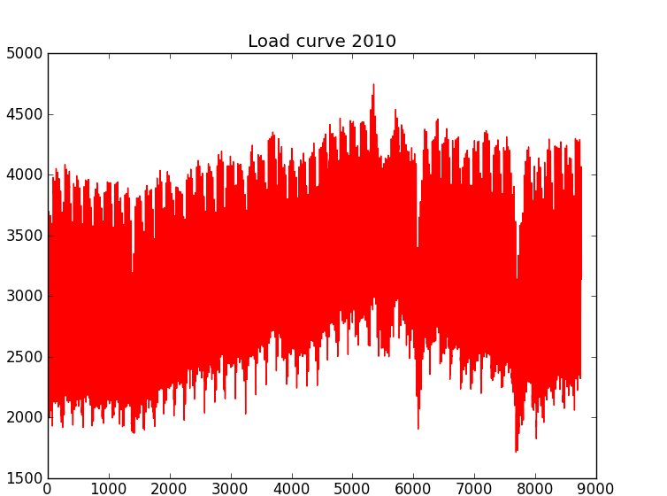
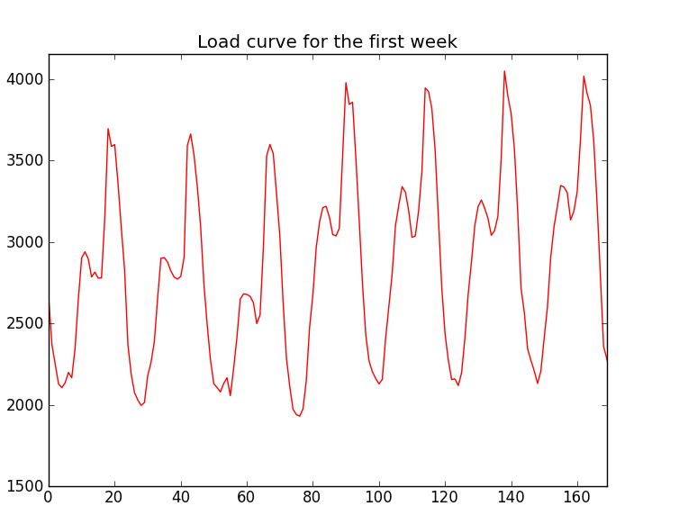
Country Profile
Load curve in Morocco
Load [MW]
Load [MW]
Year‘s hours [h]
Year‘s hours [h]
Morocco Load curve for 365 days in 2010 (hourly resolution)
Morocco Load curve for the first week in 2010 (hourly resolution)
Source: The National Electricity Company of Morocco ONEE, 2012

Slide 8
Country Profile
Load curve
Two peak periods per day
Load [MW]
Day [Hours]
averaged daily load in 2010
Source: The National Electricity Company of Morocco ONEE, 2012

Slide 9
Outline
Background
Country Profile
Methodology
Scenarios definition
Optimal mix analysis
Storage model
Optimal mix results
Discussion
Conclusion

Slide 10
Methodology
Data collection
Meteorological Data
Load curve Data
Discussion of results
Modelling of 3 scenarios
Analytical Approach
Wind electricity output
Solar electricity output
Electricity power output

Slide 11
Methodology
Scenarios definitions for the energy mix by 2020:
 | Wind a | Solar b | Hydro c | Fossil f | Share of renewables
Scenario 1 | 6.1% | 5.9% | 8% | 80% | 20%
Scenario 2 | Optimal mix of technologies |  |  | 80% | a+b+c=20%
Scenario 3 | Optimal mix of technologies |  |  | ------- | a+b+c=100%
Capacity factors are: 21% for wind, 20% for solar (own calculation) and 28% for hydropower, 60% fossils (COMELEC, 2010)

Slide 12
Methodology
Optimal mix model:
Mismatch energy (Heide et al. 2010):
γ: Excess generation factor
a: Fraction of the load is covered by wind
a+ b+ c+ f= 1
W(t): total wind power generation during time t
<W>: average wind power generation
Assumption: Fossil and hydropower are time independent
h(t)=<h> and F(t)=<F>
Based on the maximum potential of Hydropower in Morocco (5 TWh/year), h is limited to 8.3% by 2020 (MED-CSP,2005)
Source: Seasonal optimal mix of wind and solar power in a future, highly renewable Europe, Heide et.al 2010

Slide 13
Methodology
→ Excess generation
→ Deficit generation

Slide 14
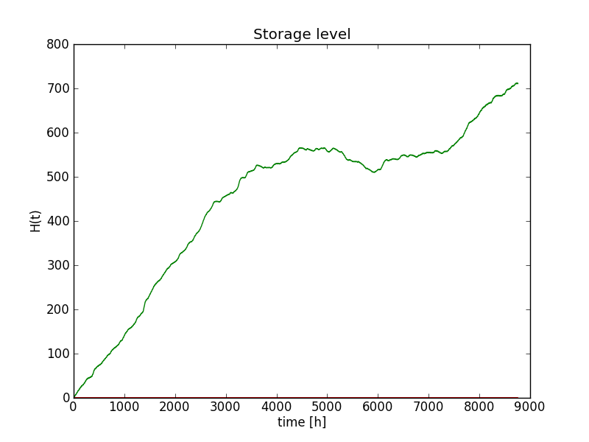
Methodology
Mismatch energy is a key to determine the storage needs
Storage model
H(t): total storage during time t
E_{H} : required storage
Required storage

Slide 15
Outline
Background
Country Profile
Methodology
Scenarios definition
Optimal mix analysis
Storage model
Optimal mix results
Discussion
Conclusion

Slide 16
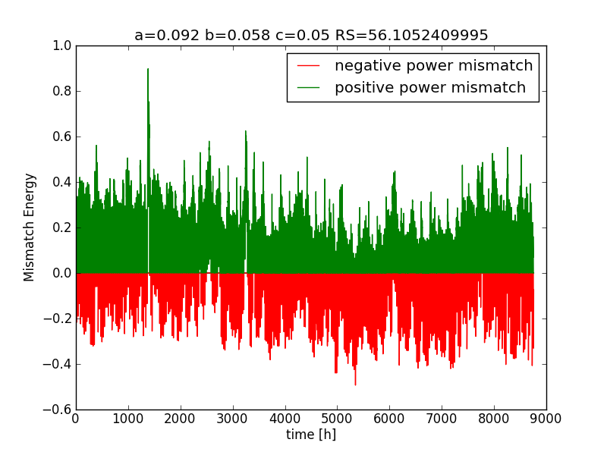
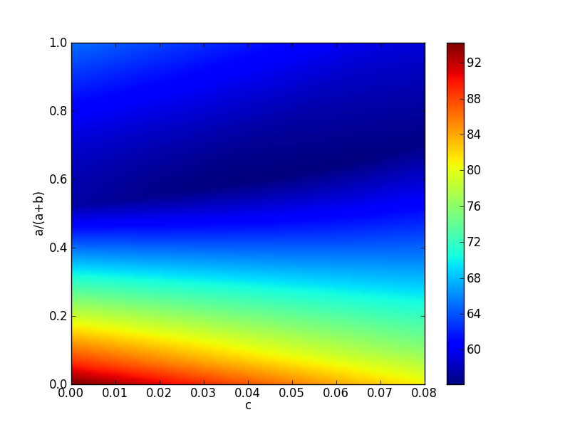
Results and Findings
Optimal mix of renewables for the National Energy Strategy in Morocco
Scenario 2
@ γ=1.1 and 90% storage efficiencies
a= 9.2%, b= 5.8% and h= 5%
Storage
Required storage

Slide 17
Results and Findings
Capacity factors are: 21% for wind, 20% for solar (own calculation) and 28% for hydropower, 60% for fossils (COMELEC, 2010)

Slide 18
Results and Findings
Based on the share of energy generations, the required installed capacity of each renewable power technology can be calculated
Scenario 3 | Optimal mix % energy | Energy Generated TWh | Installed Capacity GW
Wind | 34 % | 20 | 11
Solar | 58 % | 35 | 20
Hydro | 8 % | 5 | 2
Total | 100 % | 60 | 33
Capacity factors are: 21% for wind, 20% for solar (own calculation) and 28% for hydropower, 60% for fossils (COMELEC, 2010)

Slide 19
Outline
Background
Country Profile
Methodology
Scenarios definition
Optimal mix analysis
Storage model
Optimal mix results
Discussion
Conclusion

Slide 20
Discussion
Summary of optimal mix results
 | Scenario 1 | Scenario 2 | Scenario 3
Required Storage av.h.l | 61 | 56 | 278
Total installed capacity GW | 15 | 15 | 33
Capacity factors are: 21% for wind, 20% for solar (own calculation) and 28% for hydropower, 60% for fossils (COMELEC, 2010)

Slide 21
Discussion
Optimal mix of renewables for the National Energy Strategy in Morocco
a= 9.2%, b= 5.8% and h= 5%
Storage

Slide 22
Outline
Background
Country Profile
Methodology
Scenarios definition
Optimal mix analysis
Storage model
Optimal mix results
Discussion
Conclusion

Slide 23
Conclusion
Energy transition implies multiple challenges of various dimensions
Meteorological planning for designing a renewables National Energy Strategy is important because:
Renewables are highly dependent on weather conditions
In order to estimate the required pack up capacities
To minimize the needs for storage and balancing energies
… for the future analyses
Analyses of long term data
Integration of cost as a driving force
Implantation of specific renewable technologies in the model, e.g. CSP

Slide 24
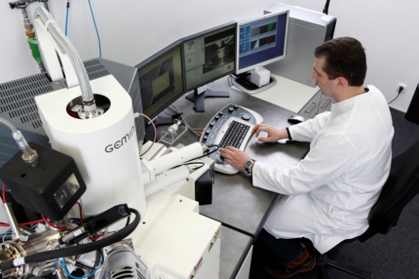
NEXT ENERGY – Energy Research for the Future
Thank you for your attention!

